Slide 1
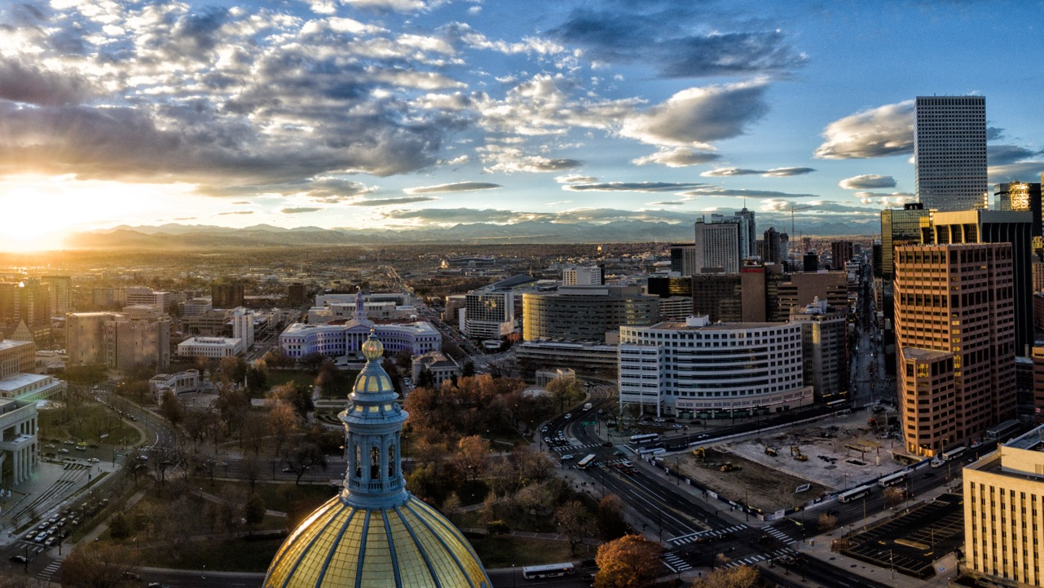
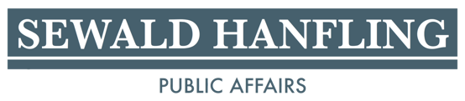
AC-REP BAPP 2024 Election Preview

Slide 2
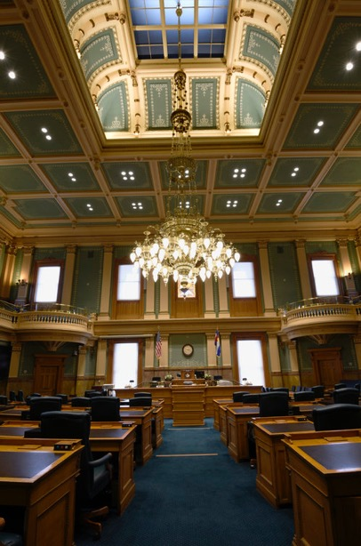
Senate
House
23 Democrats
12 Republicans
35 Legislators
3 Competitive Seats
46 Democrats
19 Republicans
65 Legislators
12 Competitive Seats

Slide 3
District 1
Diana DeGette (D)
Valdamar Archuleta (R)
District 2
Joe Neguse (D)
Marshall Dawson (R)
District 3
Adam Frisch (D)
Jeff Hurd (R)
District 4
Lauren Boebert (R)
Trisha Calvarese (D)
District 5
River Gassen (D)
Jeff Crank (R)
District 6
Jason Crow (D)
John Fabbricatore (R)
District 7
Brittany Pettersen (D)
Sergei Matveyuk (R)
District 8
Yadira Caraveo (D)
Gabe Evans (R)
Congressional Elections

Slide 4
On the 2024 Statewide Ballot
Amendment G: Modify Property Tax Exemption for Veterans with Disabilities
Amendment H: Judicial Discipline Procedures and Confidentiality
Amendment I: Constitutional Bail Exception for First Degree Murder
Amendment J: Repealing the Definition of Marriage in the Constitution
Amendment K: Modify Constitutional Election Deadlines
Amendment 79: Constitutional Right to Abortion
Amendment 80: Constitutional Right to School Choice
Proposition JJ: Retain Additional Sports Betting Tax Revenue
Proposition KK: Firearms and Ammunition Excise Tax
Proposition 127: Prohibit Bobcat, Lynx, and Mountain Lion Hunting
Proposition 128: Parole Eligibility for Crimes of Violence
Proposition 129: Establishing Veterinary Professional Associates
Proposition 130: Funding for Law Enforcement
Proposition 131: Establishing All-Candidate Primary and Ranked Choice Voting

Slide 5
Amendment 80
Constitutional Right to School Choice
Will amend the Colorado constitution establishing the right to school choice for children in K-12
This will redefine school choice to include neighborhood schools, charter schools, private schools, homeschools, open enrollment options, and future innovations in education.
Arguments For
Parents should have the right to direct their children’s education and all children should have the right to equal access for a quality education. There have been legislative attacks on school choice, specifically charter schools the last several years, this amendment provides protection for school choice.
Arguments Against
This amendment could do damage to Colorado’s school funding. Parents in Colorado already have the option to send their children to a public or charter school. This amendment is an attempt to push money to private schools at the expense of kids in public school.

Slide 6
Proposition JJ
Retain Additional Sports Betting Tax Revenue
Will allow the state to retain tax revenue collected above $29M annually from the tax on sports betting.
The funds will be appropriated to the Water Plan Implementation Cash Fund to be used for funding state water projects.
Arguments For
Water resources are critical in Colorado. Colorado sports betting generated significantly more money than anticipated. Allowing the state to retain that revenue and provide a steady revenue stream for water in Colorado and will help Colorado meet the increasing water demands.
Arguments Against
This will eliminate sports betting tax refunds that the state should be required to pay back to the casinos and sports betting operators. The state should not go back on Proposition DD.

Slide 7
Amendment 131
Ranked Choice Voting
Will establish a top-four primary elections and ranked-choice voting certain elections in Colorado. Some local communities in Colorado already use ranked-choice voting.
This will apply to the U.S. Senate, U.S. House of Representatives, Governor, Attorney General, Secretary of State, Treasurer, State Legislature, CU Regents, and State Board of Education.
Arguments For
Voters should be able to vote for the candidate of their choice regardless of political affiliation. This amendment empowers young voters and voters of color. Increased diversity in who runs and wins elections including an increased number of women elected.
Arguments Against
This does not cover other elections (President, DA, local races) meaning voters will have to cast ballots in two different ways causing confusion for voters. Alaska has begun at attempt to roll back their statewide ranked choice voting system.

Slide 8
Proposition 1A Adams County –
Sales Tax for Affordable Housing
Will increase Adams County sales tax by 0.15% to be used to address Adams County’s housing shortage. Will generate $22.2 million a year.
Funds will be directed to the Maiker Housing Partners to create more affordable housing options for both rent and purchase.
Proposition 1A will sunset after 20 years
Arguments For
Increased access to affordable housing in Adams County will expand homeownership opportunities, help renters build wealth to become homeowners, and address the homelessness crisis.
Arguments Against
The ballot wording is too vague. Any increase in taxes should include a specific plan for the allocation of those additional dollars. Any increase in sales tax has an impact on local business.

Slide 9
Proposition 7A
Allow RTD to De-Bruce Funding
Will allow RTD to collect, retain, and spend all revenue it receives from all sources including sales tax revenues, grant funds and other moneys received from the state of Colorado.
This measure will not raise taxes.
Arguments For
This will allow RTD to continue to provide more transportation choices, maintain current levels of bus and rail services, repair and improve rail lines, buses, bus stops, stations, and infrastructure, maintain availability for people with disabilities, and provide transportation for youth 19 years or younger.
Arguments Against
RTD has been exempt from TABOR since 1995. RTD should be required to refund the 7-10% of its $600M in tax revenue and reduce their operating budget and return that money to taxpayers.

Slide 10
Adams 14 – 4A & 4B –
Increase Mill and Bonding
Competitive salary for staff and teachers. Increase safety and security at all schools. Provide proper heating and air conditioning. Consolidate middle schools and build a new, high-quality facility. Equal to $6.24 per $100K of home value for Adams 14 homeowners.
Westminster – 4C
Increase Bond Funding
Provide safety and security upgrades in all school buildings. Expand CTE and STEM programs for students. Upgrades and improvements to school building infrastructure. Upgrading the heating and air conditioning in school buildings. $111M approved without imposing any new tax.
Aurora 28J – 5A & 5B –
Increase Mill and Bonding
$1B Bond and $30M annual capital mill levy with no net tax increase for taxpayers. Funding to improve and enhance school facilities, infrastructure, and technology across APS. Attracting and retaining teachers by increasing salaries. Mental health resources and real-world learning for students.
Adams 12 – 5D & 5E –
Increase Mill and Bonding
$34.5M mill levy override and $830M bond for buildings. Expand access to special classes for elementary students including adding computer science classes at all schools. Hands-on courses such as architectural design, aviation, and engineering. CTE classes for grades 6-8

Slide 11
Proposition 6A
South Adams County Water & Sanitation District
Will provide a TABOR exemption for the South Adams County Water and Sanitation District which will allow SACWSD to receive state grant funding.
SACWSD is not running a surplus due to overcollection of tax revenue, if this ballot measure fails taxpayers would not receive a refund.
Arguments For
This funding will protect water quality, invest in water system upgrades, address emerging contaminants, and enhance future water supply. It will also allow the county to invest in treatment facilities to meet all federal and state water quality standards.
Arguments Against
There are already too many ballot measures interfering with TABOR.

Slide 12
Proposition 6B
Bond Increase for Hyland Hills Parks and Recreation
Will allow District to receive a bond increase of up to $90M
This will not create a new tax or increase existing taxes.
Arguments For
This will help funding for water conservation and sustainability initiatives, additional trees and shade amenities, address aging infrastructures at district facilities, and enhance entertainment facilities to further support parks and recreation amenities. These projects will be funded with no additional cost to residents.
Arguments Against
The interest on debt service is too great to take on at this time. Projects will be completed over a 20-year timeline.

Slide 13


Upcoming Dates
October 11th: Ballots Mailed
November 5: Election Day
December 2nd: Members must request the first three of their five bills.
December 16: Newly elected members to request three of their five bills.
January 8: First Day of the 2025 Legislative Session
May 7th: Sine Die
Helpful Links
2024 Blue Book Fiscal Impact Statements
2024 Blue Book

